Slide 1
Bitcoin Mining

Slide 2
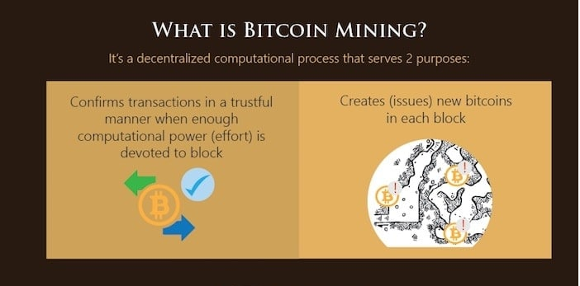

Slide 3
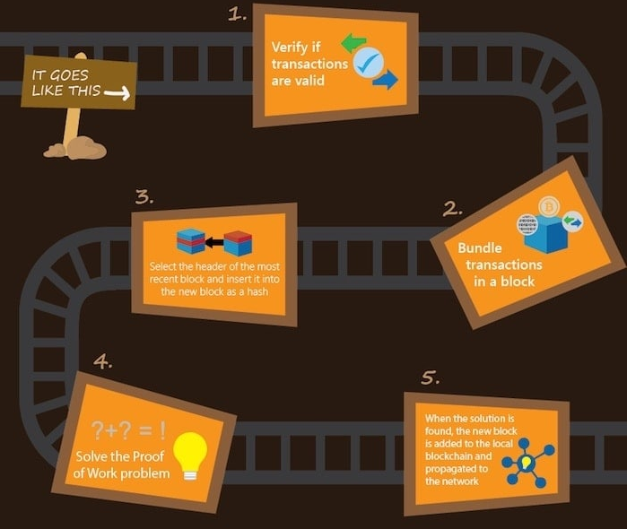

Slide 4
Transaction Validation
Checking Signature and executing Script successfully
Checking input >= output
Transaction Conflict/Double Spending
A->B 10BTC (first) 100th A:1
A->B 10BTC(second)

Slide 5

Miner collects all the transactions flooded and starts Mining

Slide 6





Block Generation Puzzle
Block Header
Block Header
Block Header
Previous Hash
Nonce
Previous Hash
Previous Hash
Nonce
Nonce
Merkle Root
Block Hash
Merkle Root
Block Hash
Merkle Root
Block Hash

Slide 7
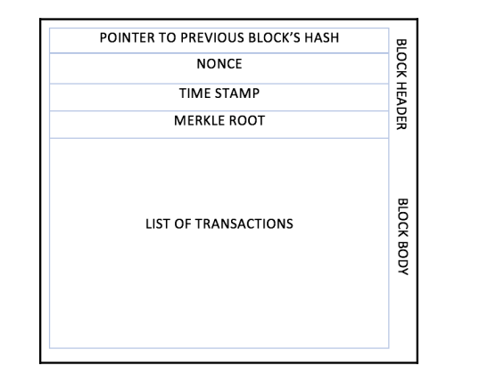
Structure of a Block:

Slide 8
Proof of Work (Block Generation Puzzle)
Find out the nonce which generates the desired hash (certain number of zeros at the prefix (target value))
0000000000000000004a2b84f93a285b7a7………= Difficulty of Mining ->Network
Hn=( H(n-1) || Transactions || Merkle Root || Nonce )

Slide 9
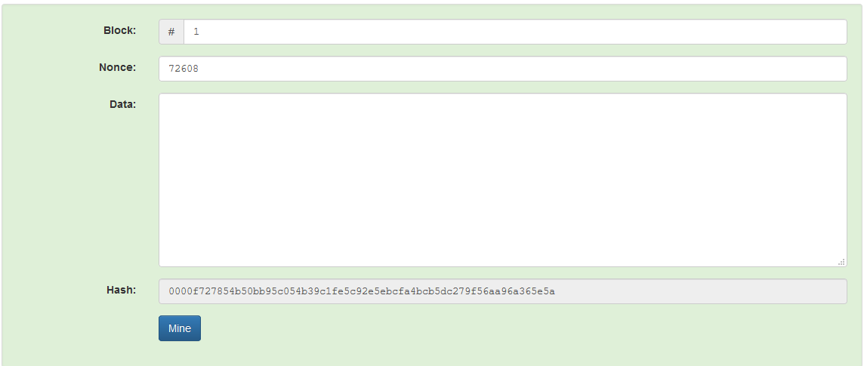

Slide 10
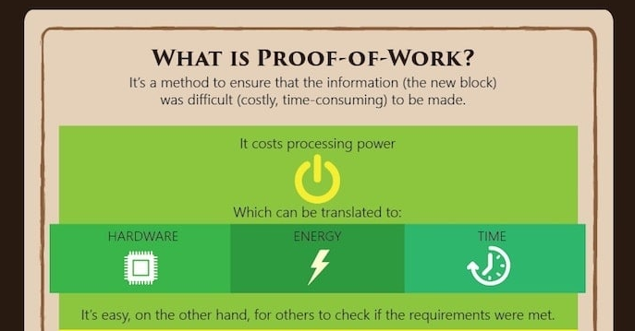

Slide 11

The miner who solves the puzzle first, generates a new block

Slide 12
Mining Demo - NiceHash

Slide 13

Block Flooding
Flood the blockchain with the new block included

Slide 14
Which Block to Relay
Block contains the correct hash based on the existing blockchain
Hn=( H(n-1) || Transactions || Merkle Root || Nonce )
All the transactions inside the block are valid
Check the scripts
Validate with the existing blockchain
The block is included in the current longest chain

Slide 15
Multiple miners can mine a new block simultaneously or in a near identical time

Slide 16
Block Propagation – Accept the Longest Chain
Block 1
Block 2
Block 5
Block 7
Block 8
Block 10
Block 4
Block 9

Slide 17
Block Propagation – Accept One of the Longest Chain
Block 3
Block 6
Block 1
Block 2
Block 5
Block 7
Block 8
Block 10
Block 4
Block 9
Block 11

Slide 18
Mining Difficulty
A measure of how difficult it is to find a hash below a given target
Bitcoin difficulty is a measure of how many hashes (statistically) must be generated to find a valid solution to solve the next Bitcoin block and earn the mining reward.
Bitcoin network has a global block difficulty
The difficulty changes for every 2016 blocks
Desired rate – one block each 10 minutes
Two weeks to generate 2016 blocks
The change in difficulty is in proportion to the amount of time over or under two weeks the previous 2016 blocks took to find.

Slide 19
Setting the Difficulty
Compute the following for every two weeks
current_difficulty = previous_difficulty *
(2 weeks in minutes)/(minutes taken to
mine last 2016 blocks)

Slide 20
2weeks(min) = 20160
Current difficulty = 300

Slide 21
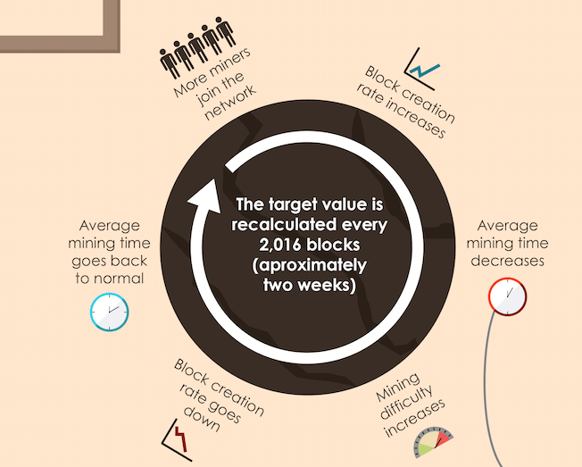
Difficulty Formula

Slide 22
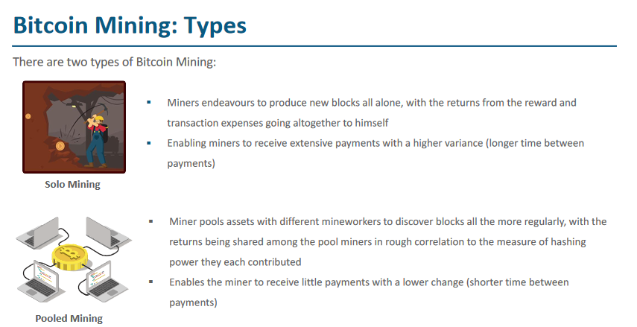

Slide 23
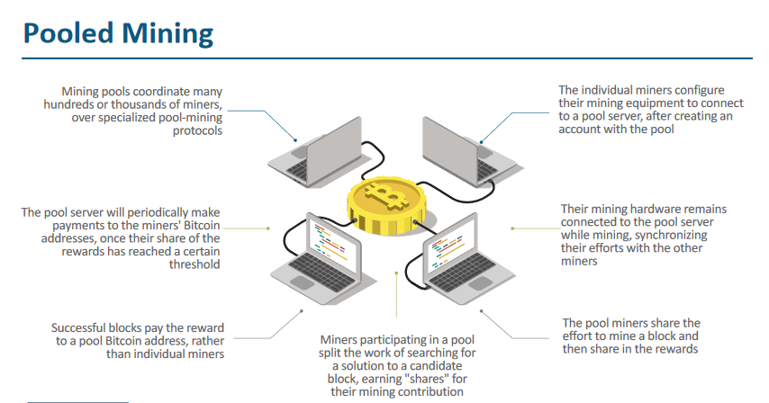

Slide 24
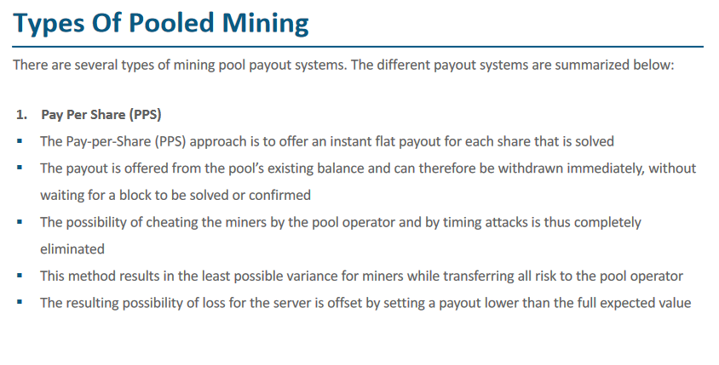

Slide 25
